Slide 2


Slide 3


Slide 4
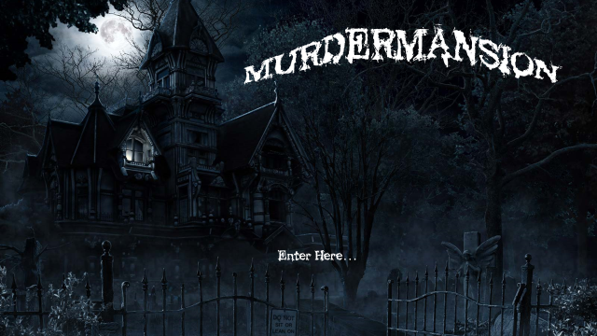

Slide 5
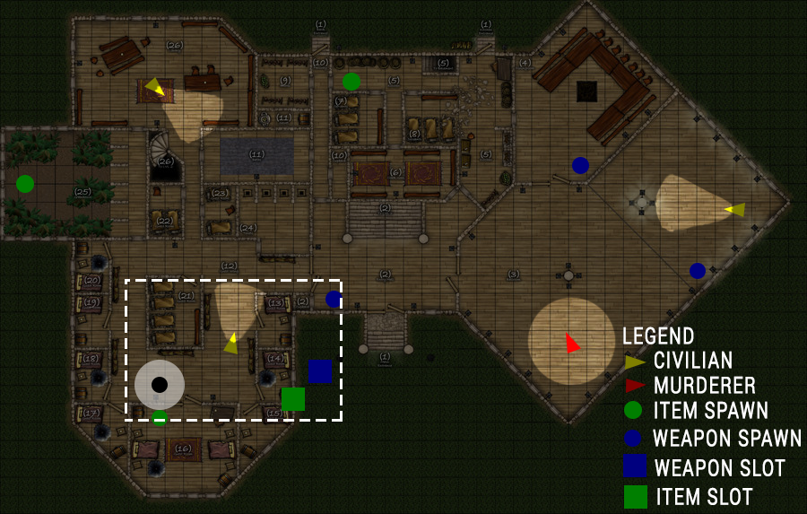

Slide 6
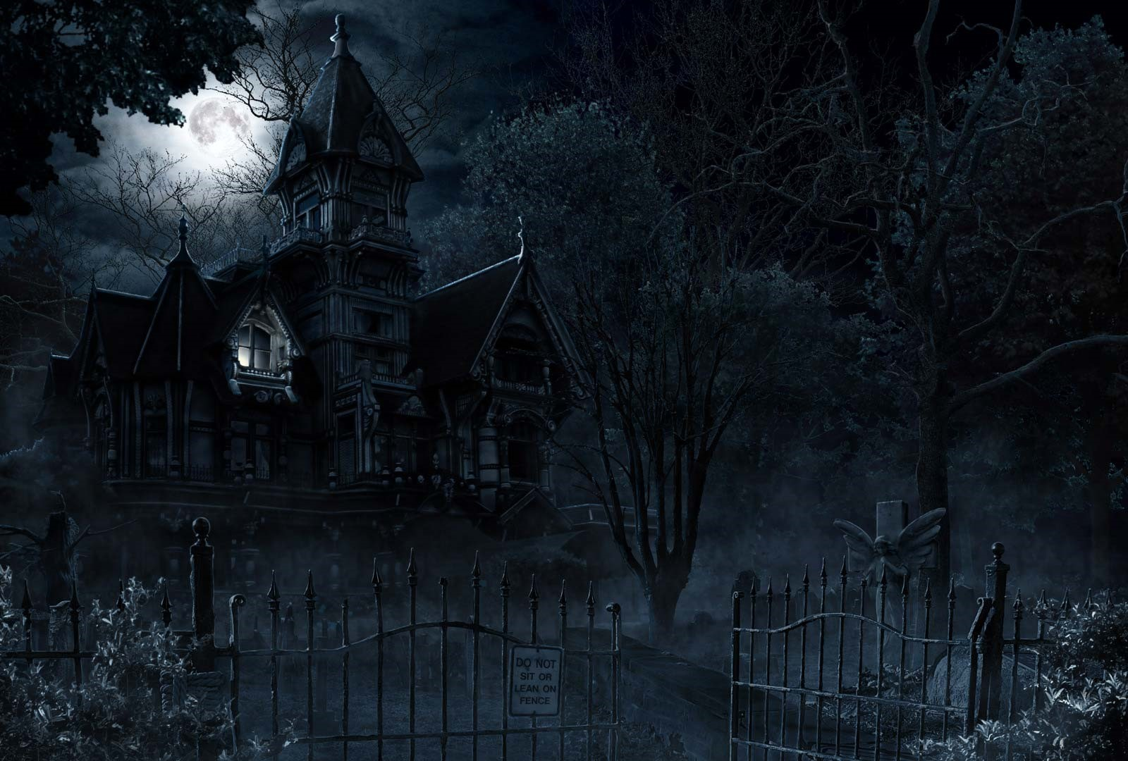
Civilian
Survive the night
Item of Choice:
Disarm Trap
Weapon of Choice:
Bat
Alternative Weapon:
Shotgun

Slide 7
Murderer
Eliminate all civilians
Special Ability:
Disguise
Item of Choice:
Trap
Weapon of Choice:
Knife

